Slide 1
Unified Mentor Data Science Internship Program
Project 1 - Supply Chain Management Dashboard
Project 2 - Chatbot

Slide 2

Strategic Insights into Supply Chain Management

Slide 3

INTRODUCTION
This presentation provides an in-depth analysis of our sales data, focusing on crucial metrics such as Revenue trends, Defect rates, and other business-critical insights. By examining product performance, customer demographics, supplier efficiency, and shipping carriers, we aim to answer key questions that impact business growth and operational efficiency. This data-driven approach highlights opportunities for improvement and supports strategic decision-making.

Slide 4
Quick look into the Data
Before exploring detailed insights and answering key business questions, let’s first review some key metrics such as total sales, total revenue, top products, regional sales and customer demographics. This high-level overview will provide a snapshot of the current business performance.
Following this summary, we will dive deeper into each visual representation to extract actionable insights that can support business growth and profit maximization.

Slide 5
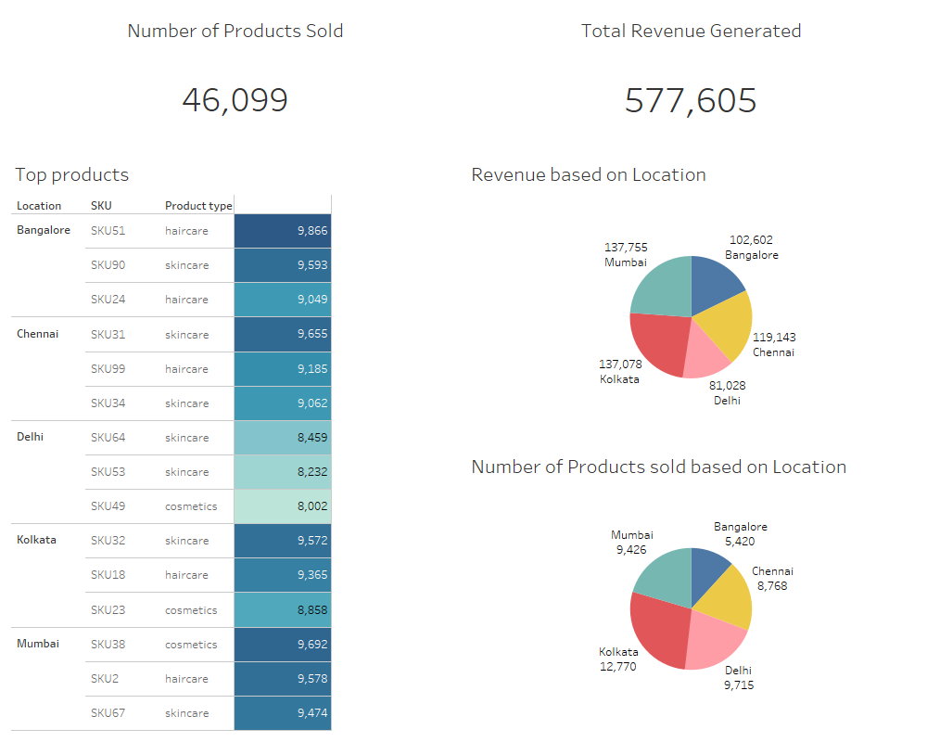

Slide 6
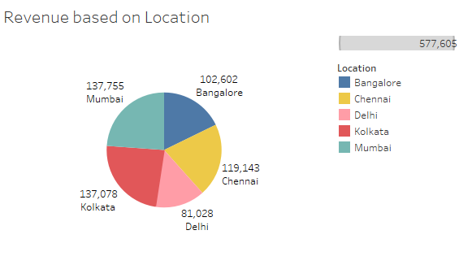
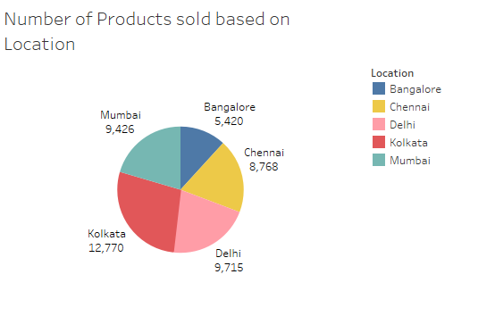
Sales Distribution by location
These pie charts provide a clear overview of the locations generating the highest sales and revenue. It is evident that Kolkata leads in both sales and revenue. Additionally, while Bangalore has comparatively lower product sales, it is generating nearly the same revenue as other cities.

Slide 7
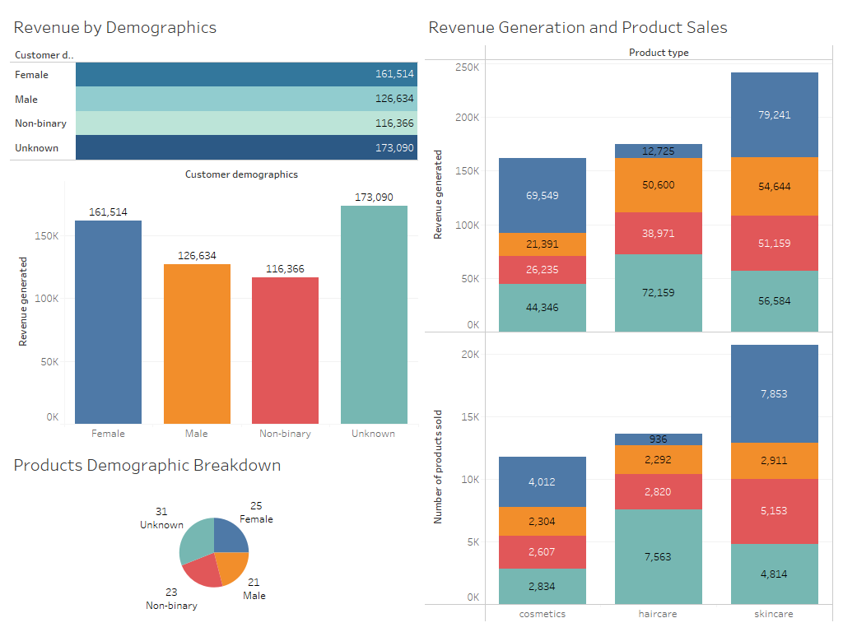

Slide 8
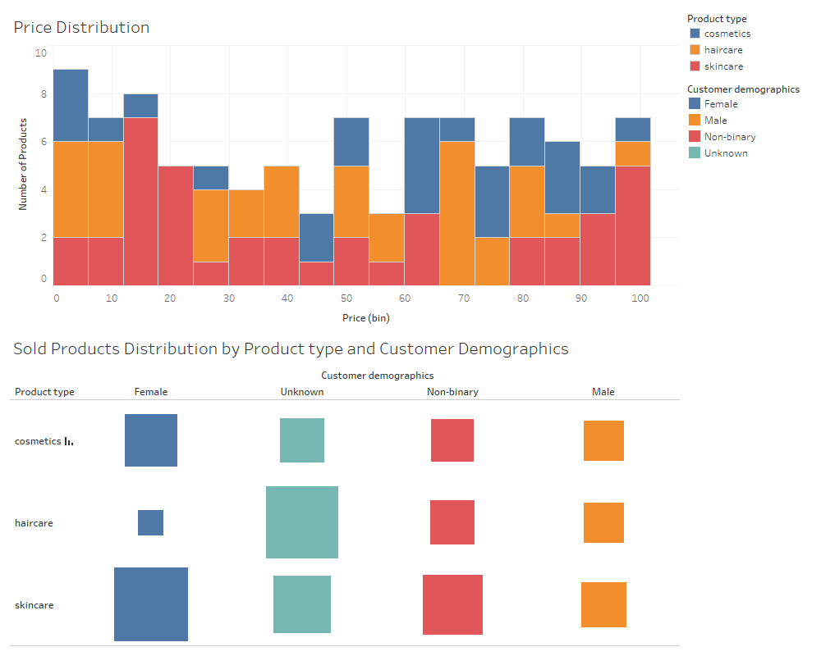

Slide 9
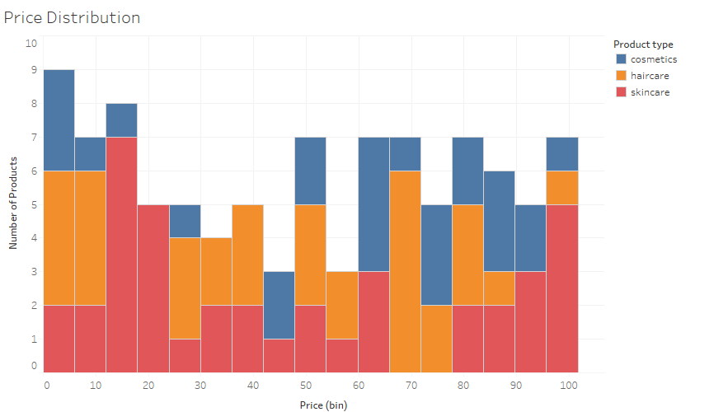
This visual shows the price distribution of the products across different product type.
Cosmetics products are mostly in the range of 45-100 with a few products in the 0-15 price range too.
Haircare products are almost evenly distributed throughout. However there are fewer products costlier than 85
Most of the skincare products are in the price range of 0-25 and 80-100. However there are a few products in the range of 25-65 too. This suggests that skincare products prices are more diverse than the other two.

Slide 10
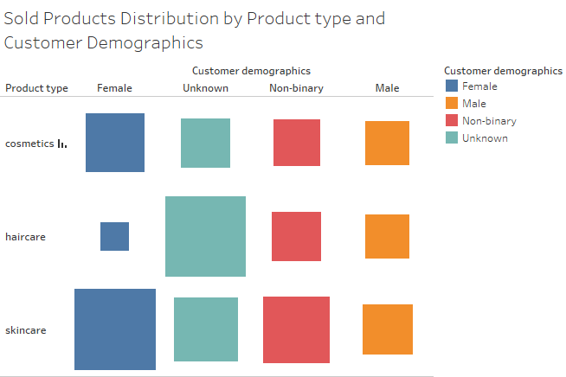
This visual shows that what are the target groups for different products.
The sales of cosmetic products are nearly uniform across all customer demographics, with a slight increase for female customers.
The sales of haircare products is the most for gender neutral products.
The sales of skincare products are nearly uniform across all customer demographics, with a slight increase for female customers.

Slide 11
Understanding Business Problems
Now that we’ve reviewed the data summary, it's time to dive deeper into the analysis and extract meaningful insights.
Rather than searching for insights randomly, a more effective approach is to outline key questions first, then use the data to answer them.
This method will help us stay focused, ensuring we understand what information we need from the data and where we are headed.

Slide 12
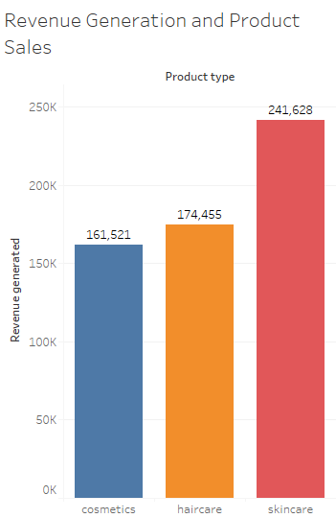
Critical Questions from the Sales Analysis
Which Product type generates the highest revenue and what are the top products from each product type?
The following bar graph illustrates that skincare products generates the highest revenue with a total of 241,628 followed by haircare products with a total of 174,455, and lastly cosmetics products at 161,521

Slide 13
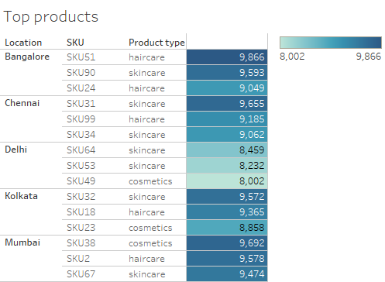
The following table shows the top products from each type for every location giving us a comprehensive summary of which products are performing the best in the market.

Slide 14
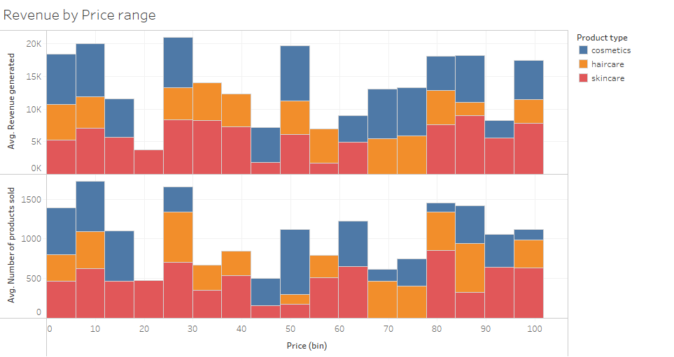
Products of what price range is doing good in the market. Which price range performance is concerning and needs attention?
We can observe smaller bars in the middle of the visual for skincare products, indicating that they are struggling in the market. Cosmetic products in the price range of 65-85 also show comparatively lower sales, while haircare products maintain consistent sales across all price ranges.

Slide 15
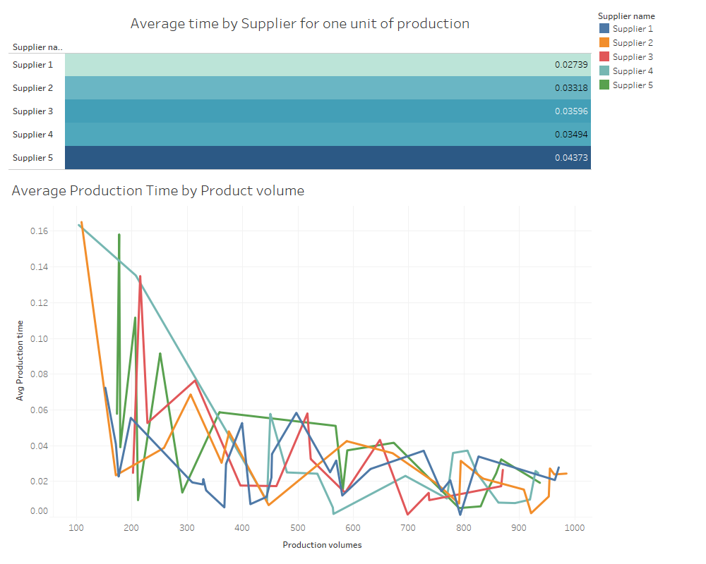
Which suppliers have the most efficient manufacturing process?

Slide 16
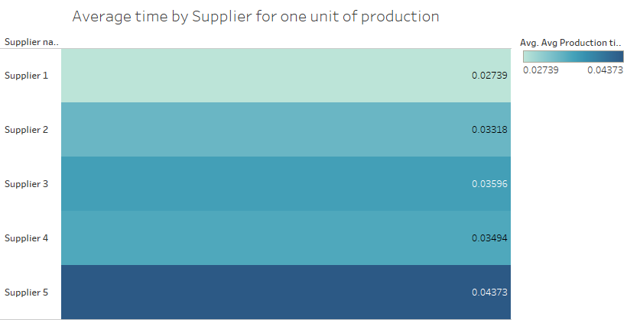
This visual illustrates that supplier 1 takes the least amount of time for one unit of production.

Slide 17
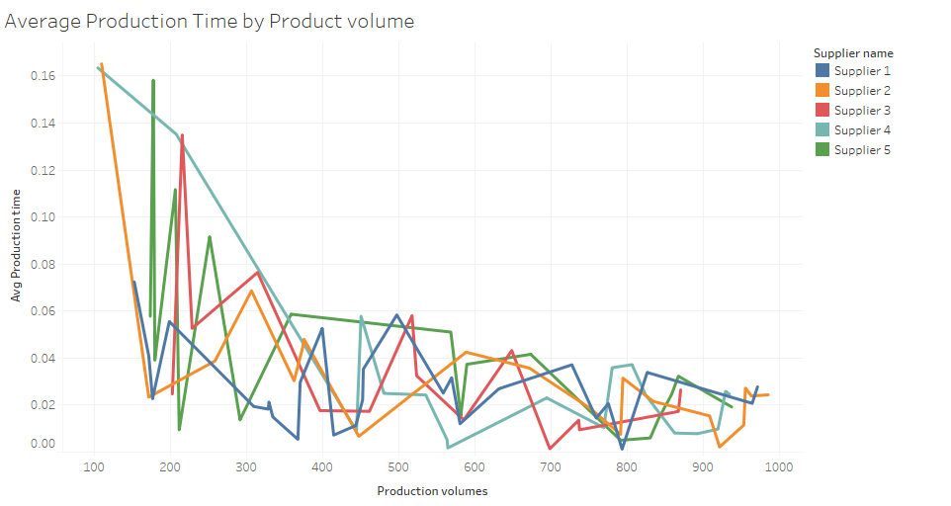
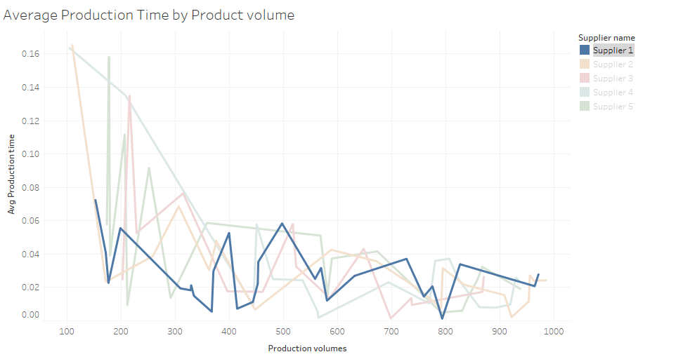
From the visual, we can observe that for all suppliers except Supplier 1, lower production volumes result in higher average times. However, as production volume increases, the average time decreases, and all suppliers tend to converge around a similar average. This suggests that manufacturers follow a uniform production approach, causing the average time to rise when the volume is lower (since Average time = Total time taken / Production volume).
In contrast, Supplier 1 maintains a consistent average across all production levels, resulting in a more efficient overall production time.

Slide 18
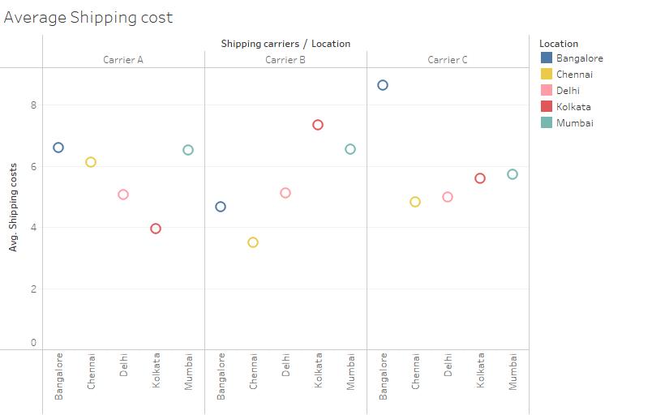
How do shipping costs vary by Shipping carriers and location?
From the following visual we can observe the average shipping cost of all the shipping carriers for different locations.
For carrier A the average shipping cost for Delhi and Kolkata is a little lower than the rest of the cities by carrier A.
For carrier B the average shipping costs for Kolkata and Mumbai is higher than the rest.
For carrier C the average cost for Bangalore is super high but consistent for the rest of the cities with the average cost between 4-6.

Slide 19
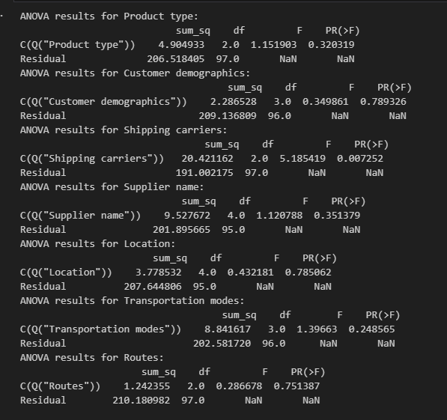
What are the significant factors affecting the Defect rates?
To answer this, we will use the statistical methods for the test of significance. We will use ANOVA test on the categorical features and regression analysis test for the continuous features.
Lets now look at the test results and its summary
ANOVA test Summary
The ANOVA test determines if two features are correlated. If the p-value is less than 0.05, we can conclude, with 95% confidence, that a correlation exists. In the output, the column "PR(>F)" represents the p-value for each feature. We observe that only "Shipping Carriers" (p-value = 0.007252) has a p-value below 0.05, indicating a significant correlation with product defect rates.
With this information, we can now create a targeted visual to explore this relationship further, without the need to generate visuals for every feature that lacks a significant correlation.

Slide 20
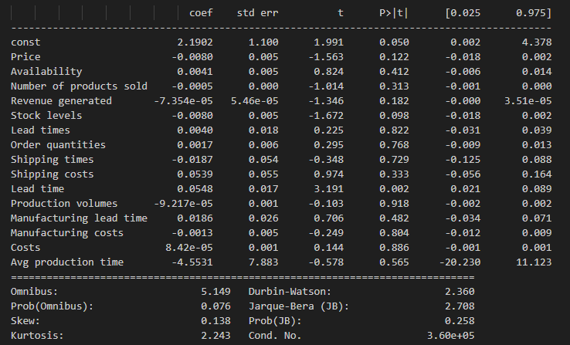
Similar to the ANOVA test, the p value determines if two features are correlated. Here the column P>|t| shows the p value.
We can see that only the feature Lead time(p value = 0.002) is significantly correlated to Defect rates.

Slide 21
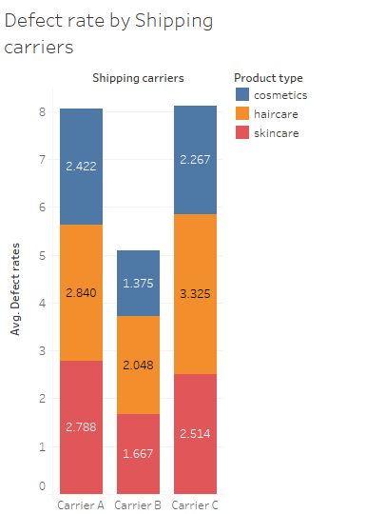
The bar graph clearly shows that the average defect rate is significantly higher for Carrier A and Carrier C compared to Carrier B, indicating that Carrier B handles products more effectively during shipping.

Slide 22
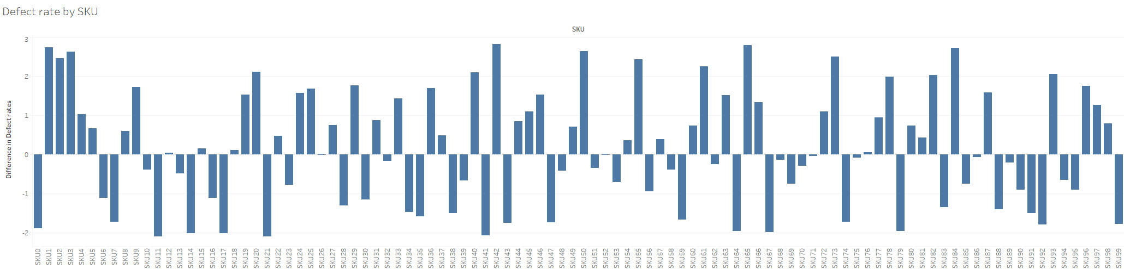
The following graph displays the deviation of defect rates for various SKUs from the median value, represented by the zero line. Bars extending above the zero line indicate SKUs with defect rates higher than the median, while bars below the zero line represent SKUs with lower defect rates.

Slide 23
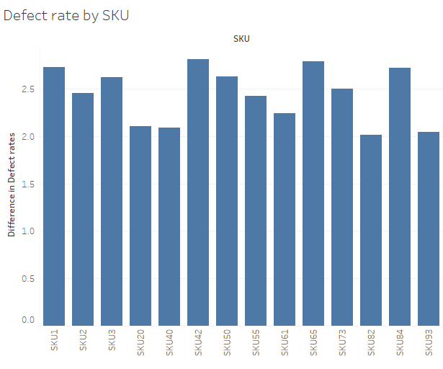
These products have defect rates more than 2 units above the median value, indicating significantly higher defect rates. With this information, we should closely examine these products to determine the underlying causes of the elevated defect rates. It’s important to assess whether the higher defect rates are due solely to the carrier or if other factors are contributing.

Slide 24
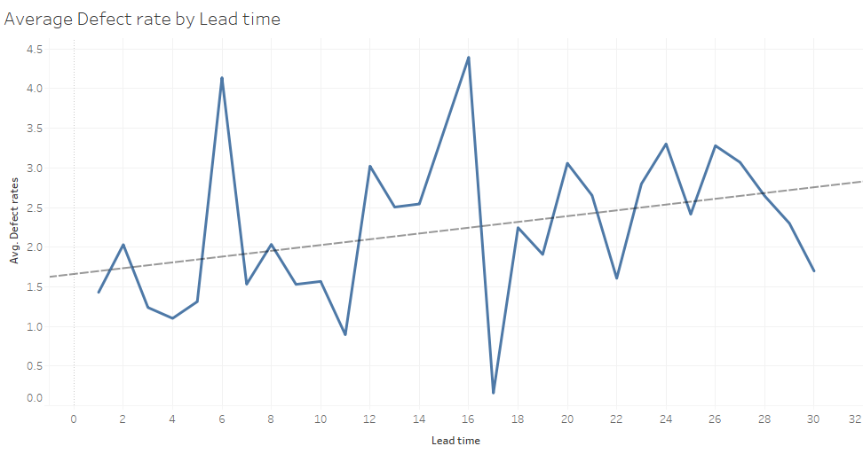
The following graph and the trend line shows that the Defect rate tends to increase when the Lead time increases. This suggests a positive correlation between Defect rates and Lead time.

Slide 25
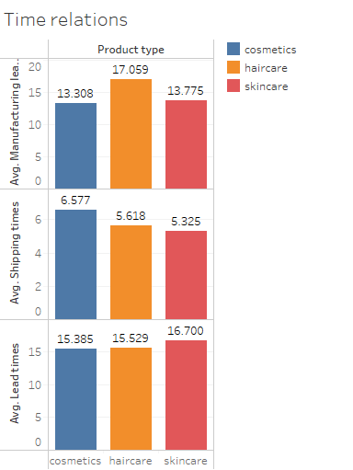
How does Product type affects the manufacturing, shipment and lead times?
For average manufacturing time, we observe that haircare products take longer to produce compared to the other product types. However, shipment and lead times are relatively consistent across all product types.

Slide 26
Conclusive Summary
After a thorough analysis, we now have a clear understanding of our business challenges and can focus on developing solutions to drive growth. To further increase profitability, we can implement the following strategies:
Reduce Defect Rates: Achieve this by selecting the most reliable shipping carriers.
Lower Shipping Costs: Optimize carrier selection based on location, while considering defect rate data to maintain quality.
Cut Manufacturing Costs: Decrease average production time by increasing batch sizes, ensuring we avoid overstocking.

Slide 27
Thank You
Presented by: Sanket Anand

Slide 28

Revolutionizing Customer Support with AI-Driven Chatbot Solutions

Slide 29

Introduction
In today's fast-paced, digital-first world, customer service plays a critical role in shaping customer experiences and business success. To meet the growing demand for immediate, reliable, and personalized support, I have developed an AI-powered chatbot.
This intelligent assistant is specifically designed to address common customer issues such as account creation, password recovery, and payment troubleshooting.
By automating these routine tasks, the chatbot significantly reduces response times, enhances customer satisfaction, and allows human agents to focus on more complex inquiries.
My solution not only streamlines the customer journey but also provides round-the-clock assistance, ensuring that customers can resolve their issues anytime, anywhere.

Slide 30
Scope of the Project
The AI-powered chatbot is designed to handle a wide range of customer support tasks to streamline the user experience and reduce reliance on human agents. The chatbot’s scope includes addressing common customer service inquiries such as:
Order Management: Assisting customers in placing, changing, or canceling orders, and tracking order status.
Account Management: Helping users create, edit, delete, or switch accounts, recover passwords, and resolve registration problems.
Shipping and Delivery Support: Providing information on delivery options, updating shipping addresses, tracking deliveries, and estimating delivery periods.

Slide 31
Payment and Refund Assistance: Addressing payment issues, offering information on payment methods, checking invoices, processing refunds, and tracking refund status.
Customer Support and Escalation: Managing customer complaints, facilitating contact with customer service or human agents, and providing responses to general inquiries.
Policy and Subscription Information: Informing customers about the refund policy, cancellation fees, and assisting with newsletter subscriptions.
This comprehensive scope ensures that customers have instant access to the information they need, enabling faster resolutions and an enhanced service experience.

Slide 32
System Architecture & Workflow:
The chatbot operates on a rule-based system, first identifying the user’s intent from their prompt and then responding with an appropriate solution from a pre-defined set of responses tailored to that intent.
Let’s break down the process step by step to understand how the chatbot functions and generates responses (each step will be explained in detail in the upcoming slides):
The user's input prompt is captured and stored.
Standard text preprocessing is applied, such as lemmatization and stopword removal.
The processed input is then transformed into a vector representation for model prediction.
A deep learning model is employed to classify the user's intent based on the input data.

Slide 33
The model outputs the probability of the prompt belonging to each possible intent class.
The intent with the highest probability is selected as the final class.
A response is then randomly chosen from the pre-generated set of responses for that intent and displayed to the user.
Suitable output for user’s intent from pre-generated responses
One hot encoding and text padding
User Input
Text Vectorization
Output Generation
01
02
03
04
05
Text preprocessing
Intent Prediction
Removing stopwords, Text lemmatization
Using Deep Learning LSTM model.

Slide 34
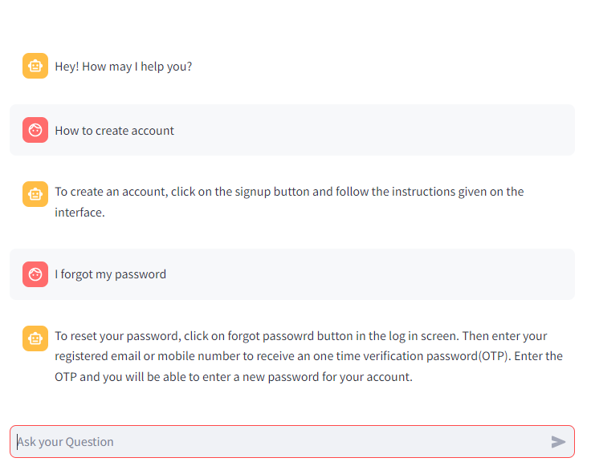
Model Overview:
The model receives user issue prompts as input and responds with the most suitable solution from a pre-generated set of responses, addressing common and frequently occurring problems efficiently.

Slide 35
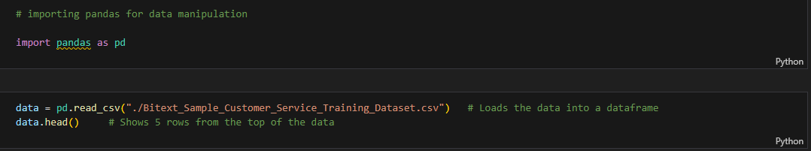
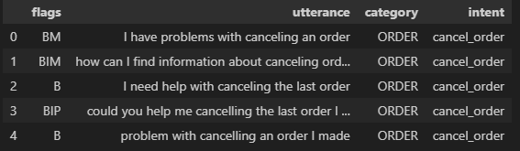
Technical Deep Dive: Behind the Chatbot’s functionality
ETL: Quick overview of the Data
Code:
Output:

Slide 36
ETL: Quick overview of the Data
The Dataset contains four different columns:
Flags: Annotations for linguistic phenomena, which can be used to adapt bot training to different user language profiles. Some flags are:
B - Basic syntactic structure
S - Syntactic structure
L - Lexical variation (synonyms), etc.
Utterance: The user input prompt to the bot.
Category: The category of the query that is prompted by the user.
Intent: The intention of the user behind the query.
Even though for the labelled dataset we have four columns, for the new prompts we know that the input will just be the user’s query. That’s why we only used the data in the utterance column to classify the intent of the user behind the query.
So we used utterance as the only feature and intent as the label to train our model.

Slide 37

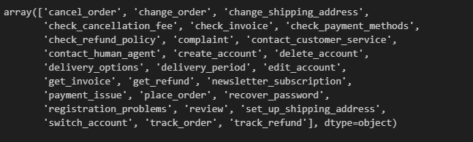
ETL: Quick overview of the Data
Code:
Output:
We have customer’s prompt for 27 different types of queries which we used to train our chatbot, to assist our users with further queries.

Slide 38
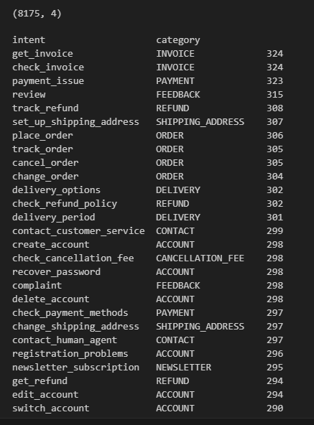

ETL: Quick overview of the Data
Output:
Code:
The shape of our data, i.e the number of rows and column is (8175,4) means 8175 rows and 4 columns.
The second line of code shows the number of records we have for every type of query intent.
We can observe that we have almost equal number of records for every type of query, so we can easily use this data for our model training without the model getting biased by a particular intent.

Slide 39
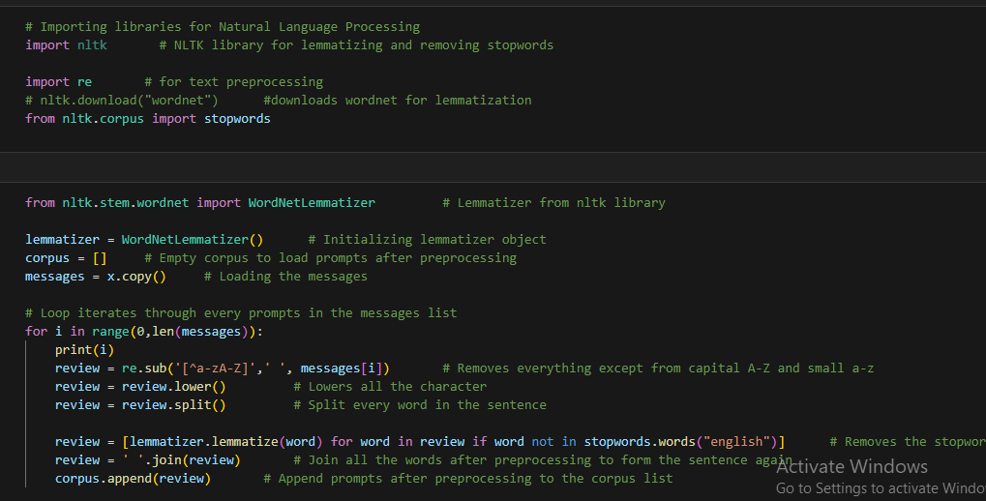
Text Preprocessing: Data preparation
Code:
This process removes stopwords from the prompts and lemmatizes each word, reducing it to its root form. This ensures consistency across different versions of the same word, preventing the model from treating similar words as distinct and assigning them different weights.

Slide 40
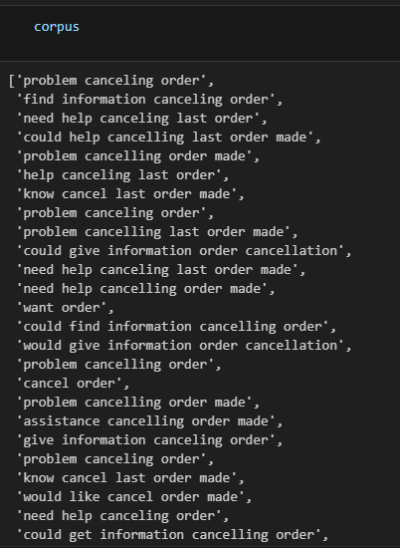
Text Preprocessing: Data preparation
This is how our prompts looks like after the preprocessing. It is evident that the unnecessary words used to form sentences, like: I, he, she, was, etc. are now removed from the corpus.
This helps avoid the model to give these words weightage in the label prediction, as we know that these words doesn’t have any significant importance in predicting the intent of the query.
Also we have reducted the words to its root form to maintain consistency across the use of same word in different verb forms.

Slide 41
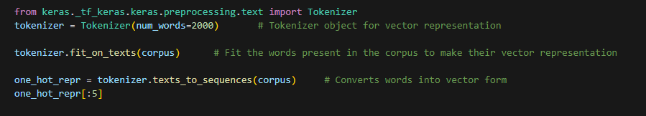
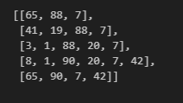
Text Preprocessing: Data transformation
Code:
Output:
This process transforms text inputs into vector form, a crucial step in Natural Language Processing (NLP), as machines cannot interpret text in its natural language. Each number in the vector corresponds to a different word.

Slide 42
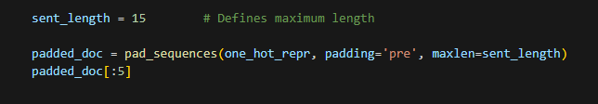
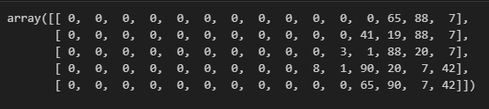
Text Preprocessing: Data transformation
Code:
Output:
This process adds zeros in the start for every prompt to unsure that the input shape for every prompt is the same. This step is very necessary as the model can’t be trained on irregular input shape. The input and output shape must be same for every instance.

Slide 43
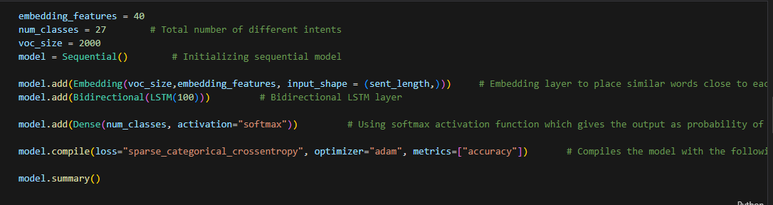
Model Architecture: Making a Deep Learning Neural Network
Code:
This code creates a deep learning LSTM model structure which we trained using our data to predict the intents when feeded with new unseen data.
Our deep learning model consists of the follwoing three layers:
Input layer: The embedding layer is our input layer.
Hidden layer: The LSTM layer is our hidden layer.
Output Layer: The last Dense layer is our output layer which uses softmax activation function to predict the labels

Slide 44
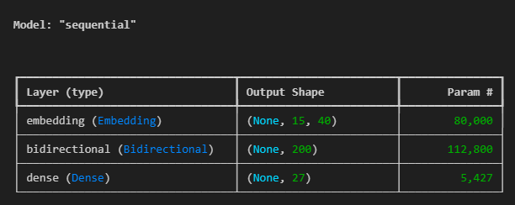
Model Architecture: Model Summary
This is our model summary. Our model has three layers.
Embedding: The Embedding layer converts each token (word) in the padded input sequence into a dense vector of a fixed size (i.e., the embedding size). These vectors are learned during training, meaning the model learns a semantic representation for each word.
Bi-directional LSTM: In a Bidirectional LSTM, two separate LSTM layers are used. One processes the input sequence in the forward direction and the other processes the input in the backward direction.The outputs of both the forward and backward LSTM layers are then concatenated at each time step. This combination allows the model to access both past (preceding words) and future (subsequent words) information simultaneously.
The final Dense layer uses the ‘softmax’ activation function and predicts the possability for the prompt to belong in each class. The output is the probability of each class and thus the output shape is 1 row and 27 columns. (Since we have 27 different intents as label.)

Slide 45

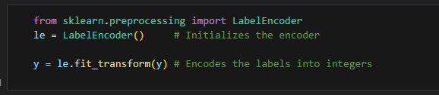
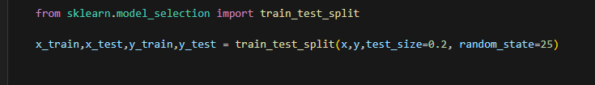
Model Training: Training Data Preparation
We did the following steps to prepare our data for model training.
Load the padded data into a new variable, so our features is ready to fit in the model.
Encode the labels into an integer representation for model training.
Split the data into two sets for training and testing purposes.
We splitted data such that 80% of the data is used for training and 20% is used for testing.
We used the testing data for model validation data.
1.
2.
3.

Slide 46
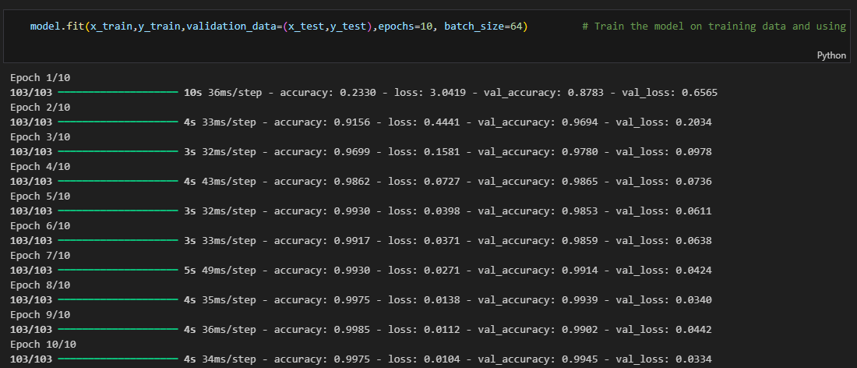
Model Training: Fitting the data
We now trained our model using the training data and validated it with the test data and obtained an accuracy of 99.75% on the training data and 99.45% on the validation data in the last epoch.

Slide 47
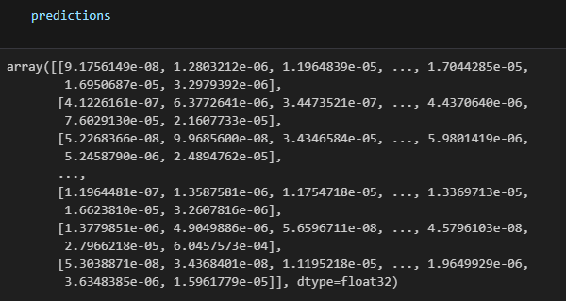
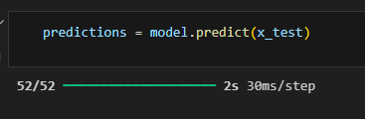
Model Evaluation: Checking prediction accuracy
To check our model performance we did the following steps:
We used our model to predict on the training data and store its predictions to check for accuracy.
Converted the output of probabilities into a single class output by using the argmax function of numpy to get the class with the highest probability.
Used the accuracy score by scik-it learn module to check how well the model performed.
1.
Output:

Slide 48

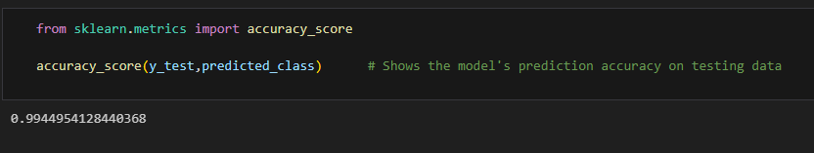
Model Evaluation: Checking prediction accuracy
2.
3.
We obtained a great accuracy of 99.45% and now our model is ready to give predictions on the real world problems.

Slide 49
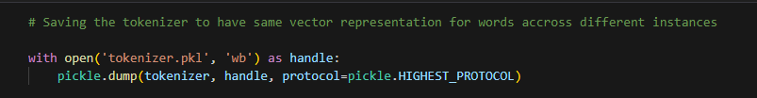
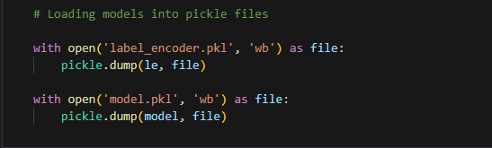
Model Serialization: Saving the models
After training the models, for prediction, tokenization and encoding labels, we saved the model so that it can be used across different instances, systems, or sessions.
Code snippets:

Slide 50

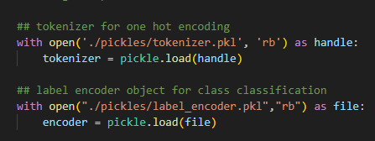
Chatbot Architecture: Loading the pretrained models
To create a working chatbot, we created a separate python file and used the streamlit library to make the user interface. The first step was to load our model, tokenizer & encoder. Loading the pretrained tokenizer is as important as loading the model because we want to ensure that our new inputs gets encoded in the same way as our training inputs.
Code:

Slide 51
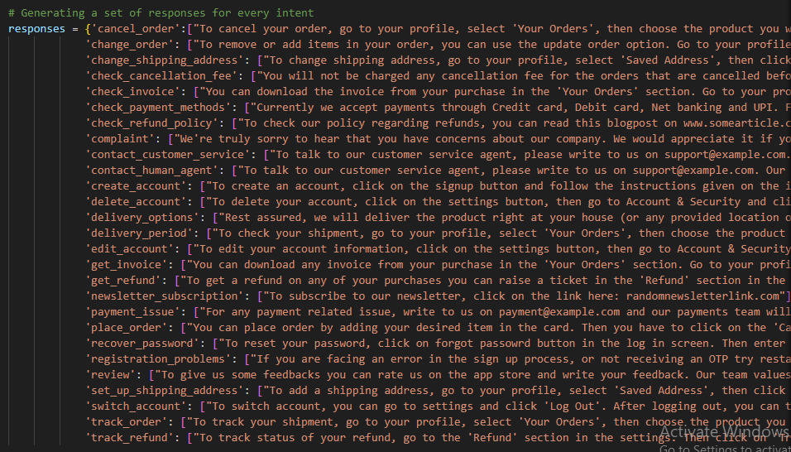
Chatbot Architecture: Generating response set
Generated a response for every intent so that the chatbot can respond to the user when a query of that particular intent arises.
Responses:

Slide 52
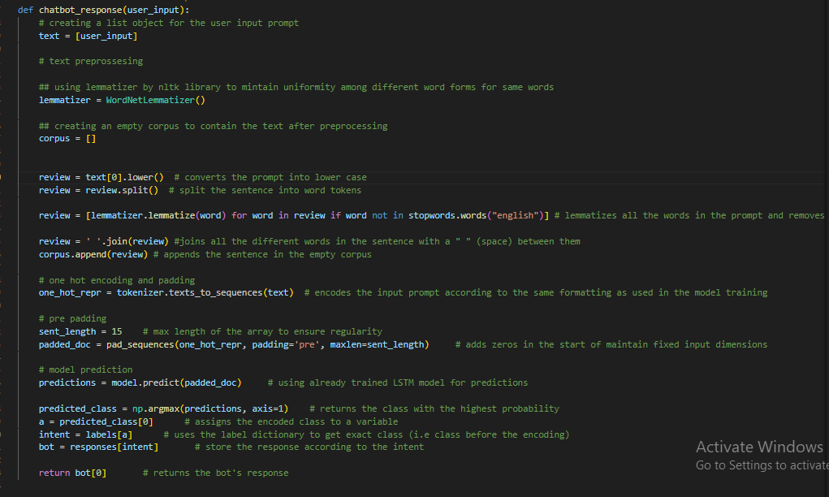
Chatbot Architecture: Function for chatbot responses
The function performs the following steps:
Takes the user input and store it.
Performs text preprocessing like removing stopwords, lemmatization.
Generate a vector representation of words using the pretrained tokenizer object
Do zero padding of the vector representation
Predict intent class using the pretrained model
Returns the response for the particular predicted intent class

Slide 53
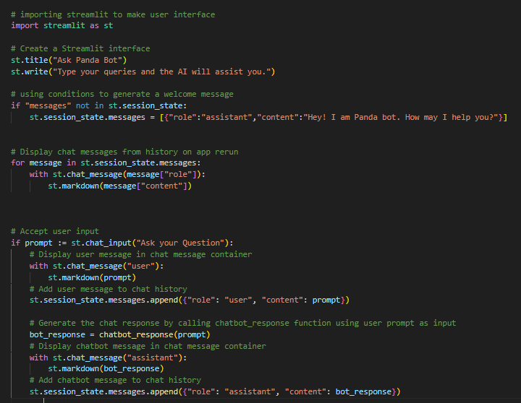
Chatbot Architecture: User Interface
The following piece of code performs these actions:
Creates a title for the homepage. (“Ask Panda Bot”)
If there are no messages in the session yet, the bot response will be to greet.
When there are new messages in the session (either by bot or the user) it is stored and displayed on the chatbox.
Whenever a prompt is entered in the textbox, the bot response function is called with the prompt as the input for the function.
The response returned by the function is displayed as the bot’s response in the chatbox.

Slide 54
Conclusive Summary
The implementation of our chatbot demonstrates a significant advancement in providing timely, efficient, and scalable customer support. By leveraging natural language processing and rule-based interactions, the chatbot is able to handle routine inquiries, troubleshoot common issues, and provide 24/7 assistance, ensuring an enhanced customer experience.
Key benefits of the chatbot include:
Improved customer satisfaction: Instant responses to queries reduce wait times and enhance service quality.
Cost-effective support: Automating routine tasks allows human agents to focus on more complex issues, reducing operational costs.
Scalability: The chatbot can handle a large volume of queries without compromising performance, making it a flexible solution as the company grows.
Future enhancements may include integrating AI-driven learning for more personalized interactions, expanding multi-language support, and seamless handover to human agents for complex issues. Overall, this chatbot positions for success in maintaining strong customer relationships in an increasingly digital marketplace.

Slide 55
Thank You
Presented By: Sanket Anand

